Slide 1
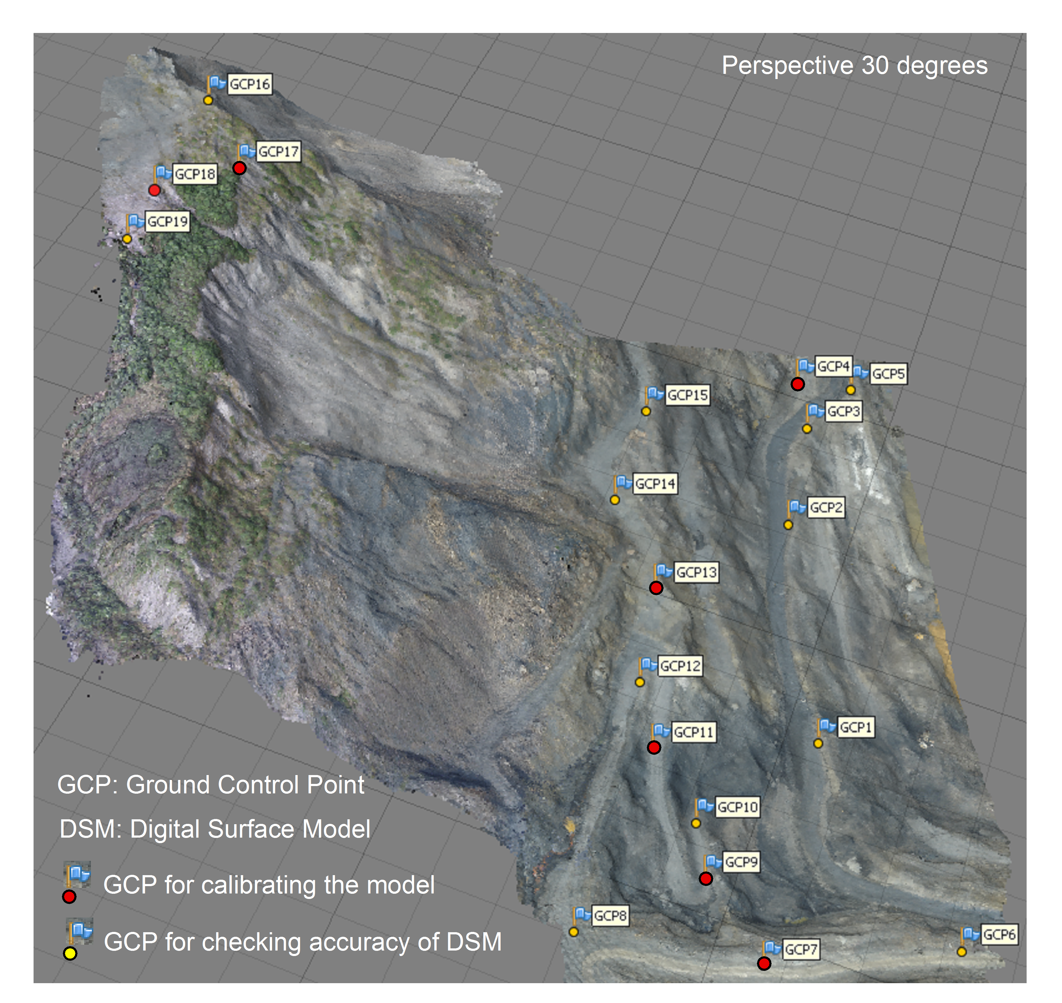
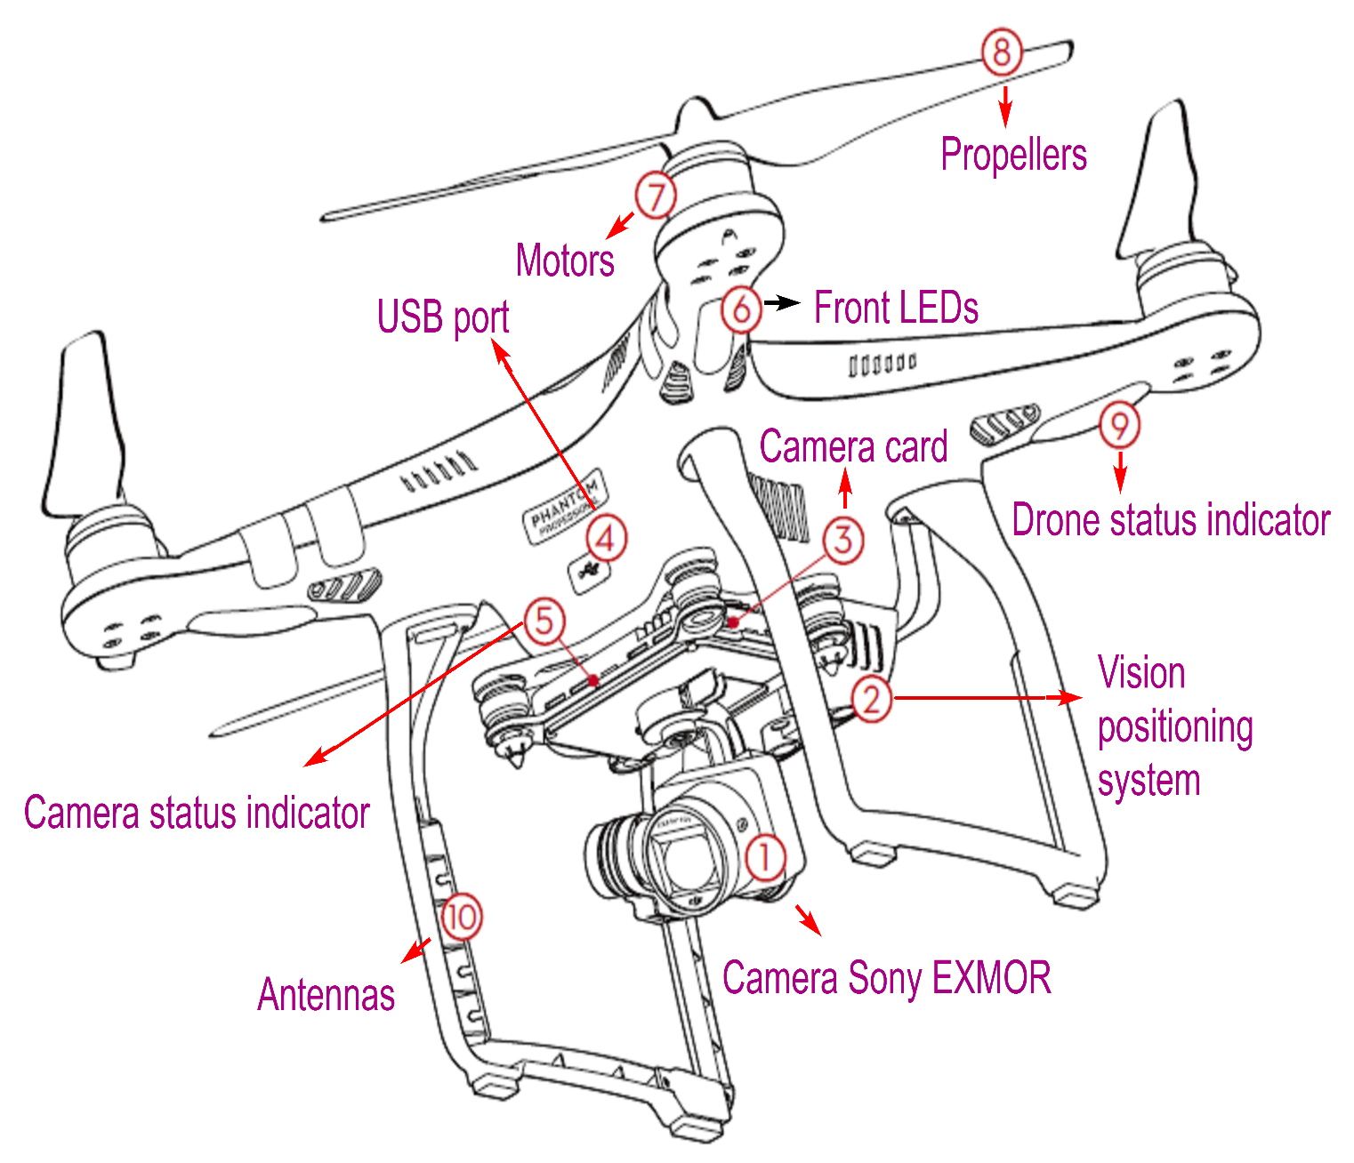
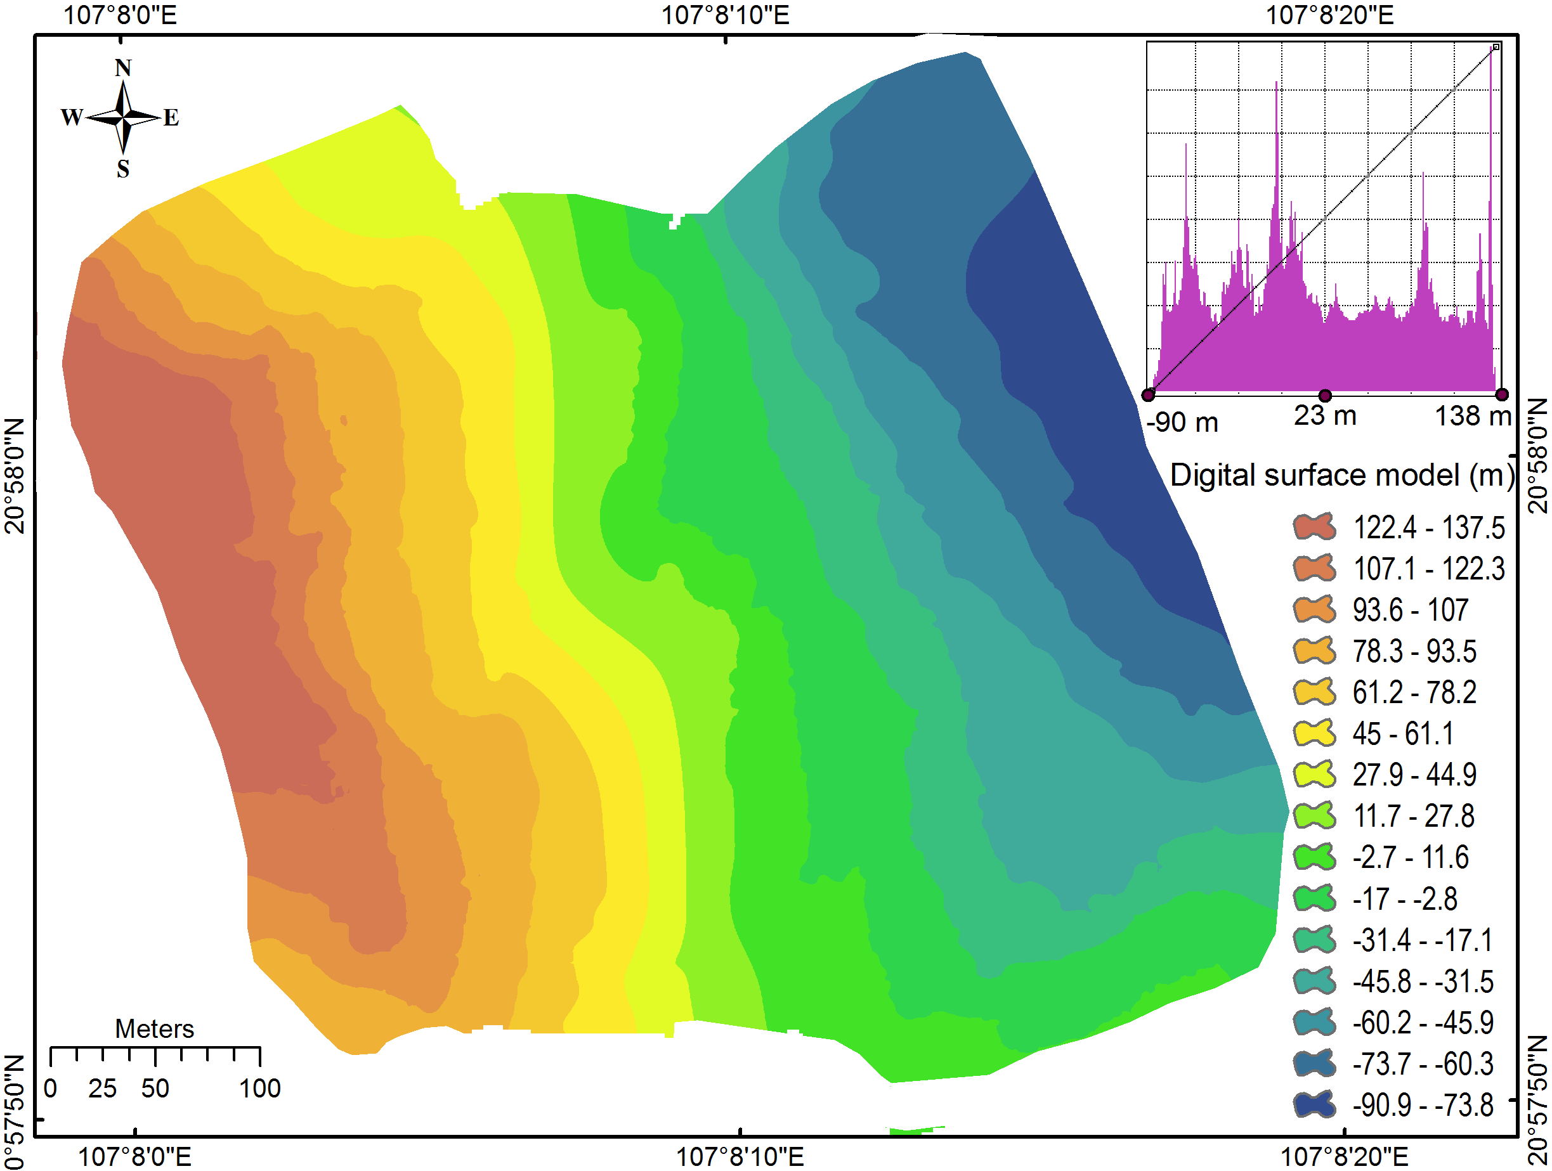
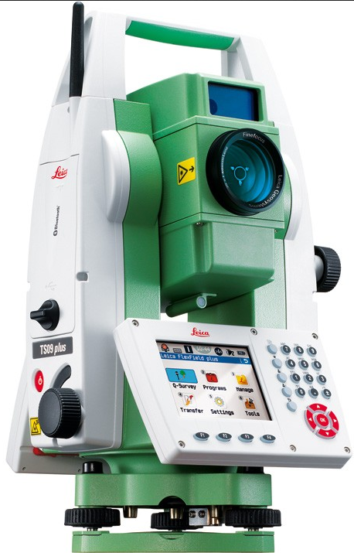
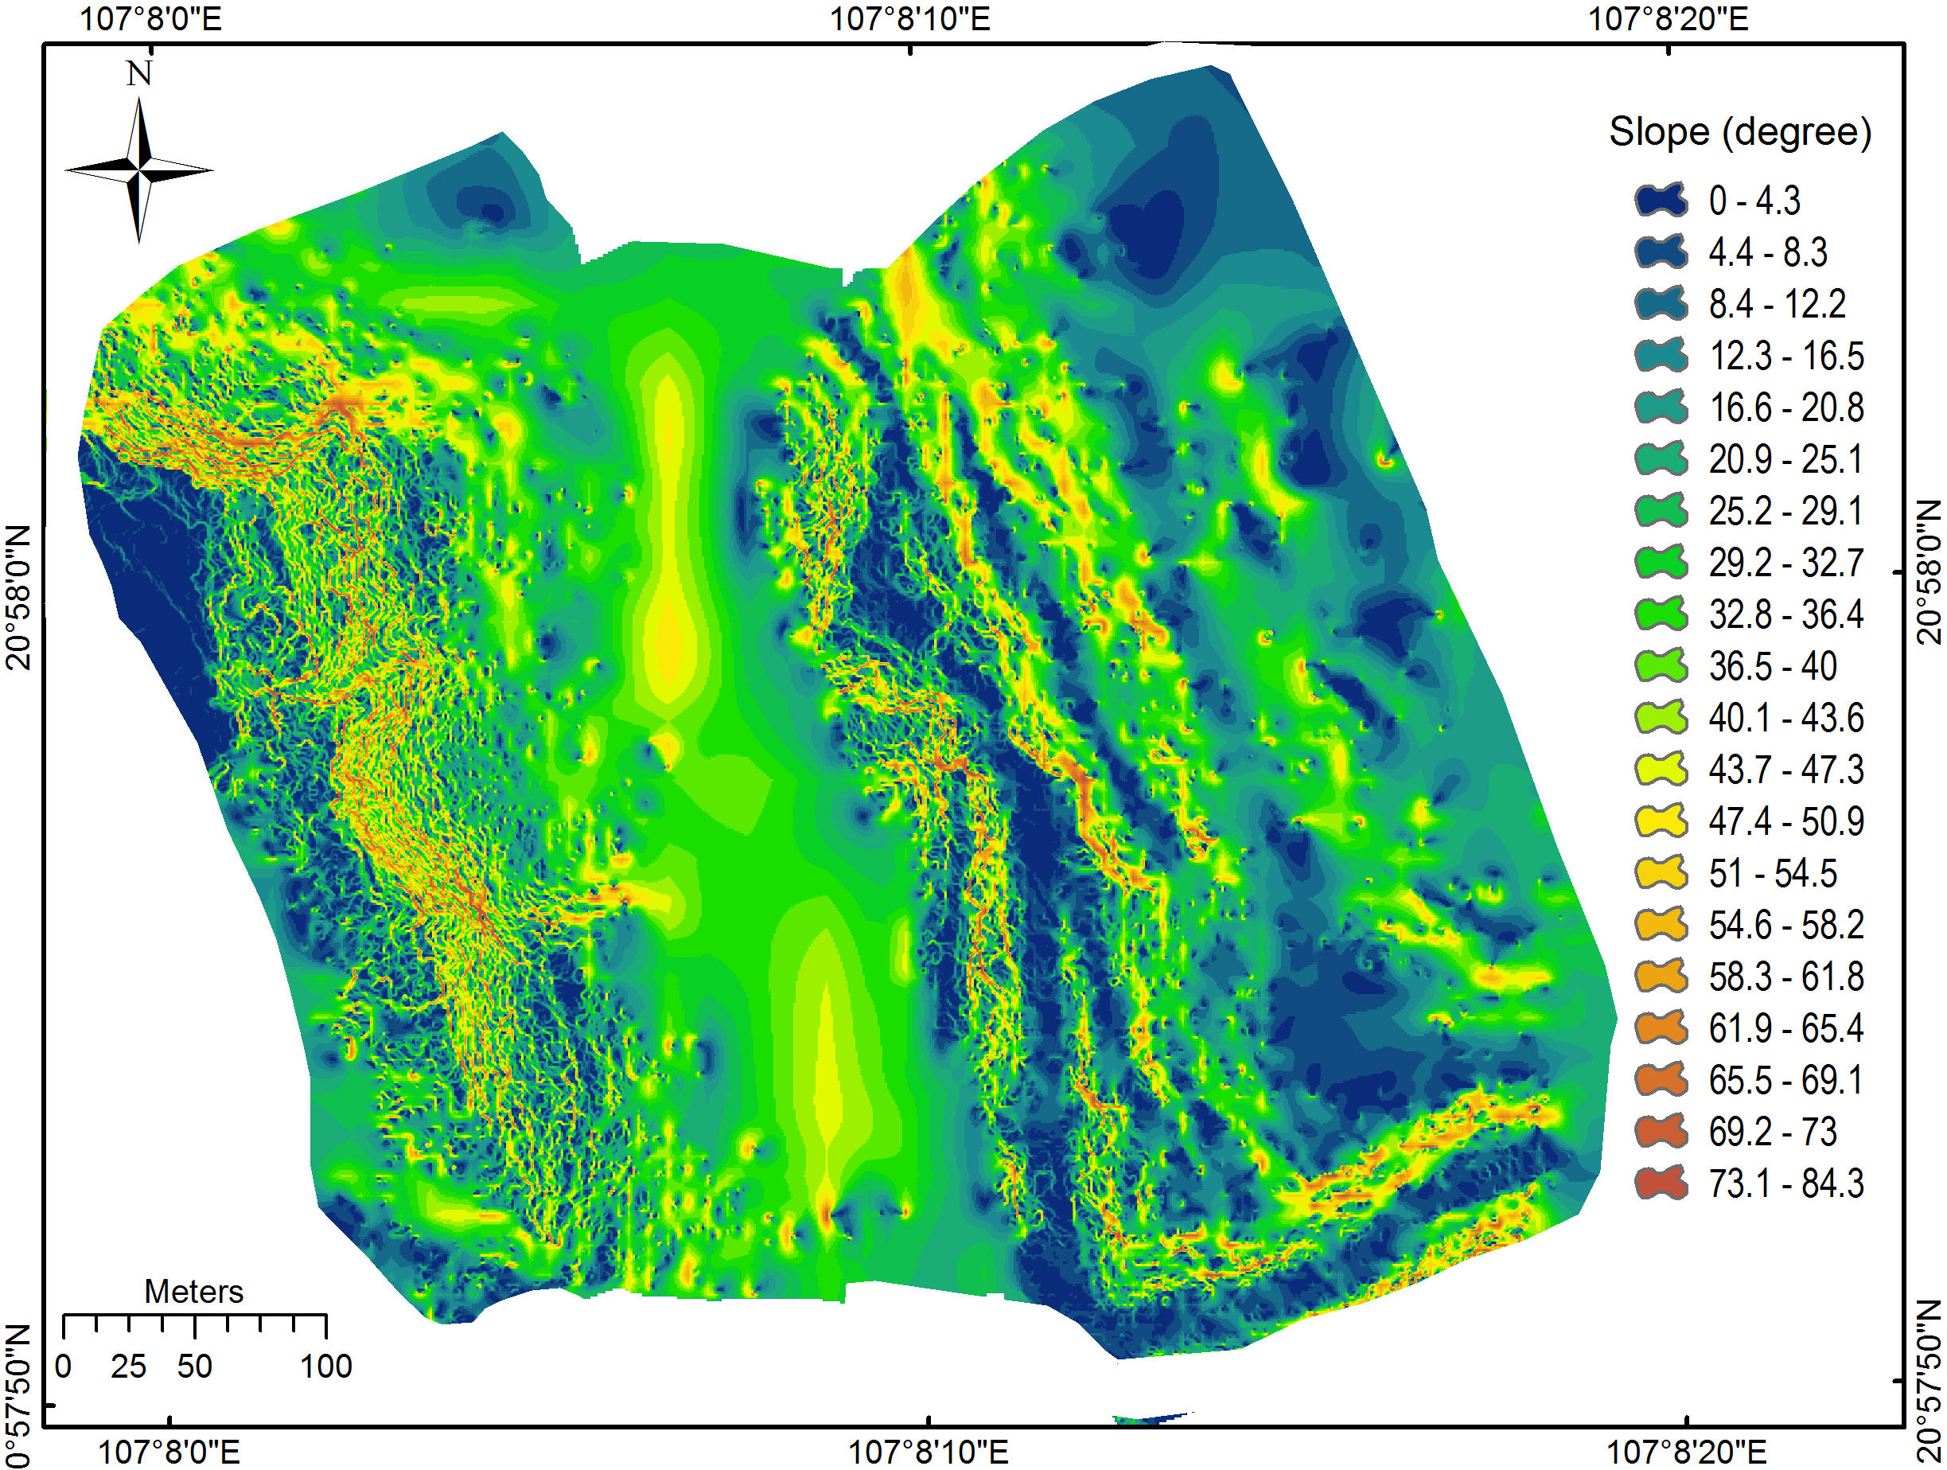
Lightweight Unmanned Aerial Vehicle and Structure-from-Motion Photogrammetry for Generating Digital Surface Model for Open-pit Coal Mine Area and Its Accuracy Assessment
Xuan-Nam Bui, ………………
Corresponding authors: buixuannam@humg.edu.vn
Recent technological innovations have led to the available of lightweight Unmanned Aerial Vehicle (UAV) and Structure-from-Motion (SfM) photogrammetry that are successfully applied for 3D topographic surveys. However, application of UAV and SfM for complex topographic areas i.e. open-pit mine areas is still poorly understood. This paper aims to investigate and verify potential application of these techniques for generating Digital Surface Model (DSM) at open-pit coal mine area and assessing its accuracy. For this purpose, the Nui Beo open-pit coal mine located in northeast Vietnam is selected as a case study. Accordingly, a total of 206 photos were captured using 19 ground control points (GCPs). The accuracy of DSM was assessed using root-mean-square error (RMSE) in X, Y, Z, XY, and XYZ components. The result showed that the DSM model has high accuracy, RMSE on the 12 calibrated GCPs for X, Y, Z, XY, XYZ is 1.1 cm, 1.9 cm, 0.8 cm, 2.2 cm, and 2.3 cm, respectively, whereas RMSE on the 7 checked GCPs is 1.8 cm, 2.4 cm, 3.2 cm, 3.0 cm, and 4.4 cm for X, Y, Z, XY, XYZ components, respectively. We concluded that small UAV and SfM are feasible and valid tools for 3D topographic mapping in complex terrains such as open-pit coal mine areas.
UAV and camera
No. | Parameter | Characteristics
1 | Total weight | 1.28 kg
2 | Height, length, width | 18.5 cm, 28.9 cm, 28.95 cm
3 | GNSS | GPS/GLONASS
4 | Max. flight altitude | 6 km
5 | Max. flight time | ~ 23 minutes
6 | Max. speed | 16 m/s
7 | Operating temperature | 0oC to 40oC
8 | Camera sensor | Sony EXMOR 1/2.3 ”, pixels is 12.76 M
9 | Camera lens | FOV 94o 20 mm f/2.8
10 | Electronic shutter speed | 8s - 1/8000s
11 | Image format | DNG, JPEG
12 | Stabilization | 3-axis (pitch, roll, yaw)
Table 1. Characteristics of the DJI Phantom 3 professional and Sony EXMOR camera used in this research.
Fig. 1. 3D dense cloud and distribution of the GCPs in the study area.
Fig. 1. DJI Fantom 3 Professional
Accuracy Assessment
Fig. 2. Leica TS09 used for this study
Fig. 4. Digital Surface Model (DSM) for the study area.
Results and Discussion
Table 4. Camera-lens calibrated coefficients
Table 5. Error and RMSE used for the model calibration
No |  | Parameter | Value | Error
 | 1 | f | 2314.550 | 0.59
 | 2 | Cx | -22.8598 | 0.1600
 | 3 | Cy | 11.4502 | 0.1000
 | 4 | B1 | 9.0365 | 0.2700
 | 5 | B2 | 2.7214 | 0.1500
 | 6 | K1 | -0.006685 | 0.000110
 | 7 | K2 | -0.008707 | 0.000390
 | 8 | K3 | 0.035100 | 0.000540
 | 9 | K4 | -0.016010 | 0.000250
 | 10 | P1 | -0.001735 | 0.000024
 | 11 | P2 | 0.000523 | 0.000009
 | 12 | P3 | -0.767175 | 0.013000
 | 13 | P4 | 0.264946 | 0.008700
Calibration Points |  | X error (m) | Y error (m) | Z error (m) | XY error (m) | XYZ error (m)
 | GCP1 | 0.029 | 0.031 | -0.007 | 0.043 | 0.043
 | GCP2 | -0.013 | -0.041 | -0.004 | 0.043 | 0.043
 | GCP3 | 0.009 | 0.025 | 0.004 | 0.026 | 0.027
 | GCP5 | -0.006 | -0.009 | 0.001 | 0.011 | 0.011
 | GCP6 | -0.005 | -0.009 | 0.002 | 0.010 | 0.011
 | GCP8 | -0.005 | -0.005 | -0.012 | 0.007 | 0.014
 | GCP10 | -0.013 | 0.017 | 0.007 | 0.022 | 0.023
 | GCP12 | 0.005 | -0.024 | 0.008 | 0.024 | 0.025
 | GCP14 | -0.002 | -0.001 | -0.017 | 0.002 | 0.017
 | GCP15 | -0.005 | 0.009 | 0.012 | 0.011 | 0.016
 | GCP16 | -0.002 | 0.001 | -0.003 | 0.002 | 0.004
 | GCP19 | 0.002 | 0.001 | 0.000 | 0.002 | 0.002
 | RMSE | 0.011 | 0.019 | 0.008 | 0.022 | 0.023
Conclution
Fig. 5. Digital Surface Model (DSM) for the study area.
This research assesses potential application of small UAV, SfM photogrammetry for generating DSM and its accuracy assessment at open-pit coal mine area. Accordingly, a lightweight and low-cost DJI Phantom 3 Professional equipped by the nonmetric RGB Sony EXMOR camera was used. A total of 206 images were captured, and in addition, 19 GCPs were established and determined XYZ coordination (VN2000/ UTM Zone 48N) using a Leica TS09 total station (1”angular accuracy and 1.5 mm + 2 ppm distance accuracy).
The result showed that the DSM model has high accuracy; RMSE in the calibrating dataset is 0.8 cm and 2.2 cm for vertical and horizontal, respectively indicating high success-rate of fit, whereas RMSE in the checking dataset is 3.2 cm and 3.0 cm for vertical and horizontal, indicating high accuracy. These indicate that the processes of capturing images, establishment of GCPs, and photogrammetric processing were carried out successfully.

